Slide 1
What History and Ethics Can Teach Us About Attorney Civility
Illinois Supreme Court Commission on Professionalism
We Can Be Civil And Effective
Notes:
:00
This is the introductory slide. Use this slide to introduce yourself and your organization and your role within the organization. If your organization performs some type of volunteer or service work and you want to explain what you do, take this opportunity to explain that as well.

Slide 2
Learning Objectives
As a result of this program, participants will learn to:
Apply classical principles of civility to modern behavior.
Defuse highly charged language/behavior before it escalates out of control.
Discover effective and ethical tools for managing incivility.
Notes:
:02
This program is focused on providing an overview of incivility within the profession, placing civility within its proper historical context, and finally, using hypothetical scenarios to address issues of incivility that might actually arise in practice. These learning objectives summarize the three-part objective of this program.
The learning objectives are essential both to obtain CLE credit, and also to offer your audience a guidepost for what you, and they, need to achieve by the end of the program. You would like to be able to return to this slide at the end of the program and conclude that you were able to achieve all of your learning objectives.
Finally, the Sample Dialogue below mentions the interactivity component of this program. We encourage you to highlight that so that your participants are aware of your expectations from the outset.
Sample Dialogue
First, I will discuss how the general public and practicing attorneys view incivility. Then I will begin the dialogue on the civility solution – how a historical understanding of civility can help us better tackle the incivility problems today. Finally, if time allows, in the context of some fact scenarios, we’ll all discuss practical and ethical tools to defuse highly charged situations using some litigation-based hypothetical scenarios. This is an interactive program. I hope that you will feel comfortable and engaged enough to ask me questions and open discussions with each other.

Slide 3
The Problem of Incivility
Notes:
:05
This slide sets the framework for the next discussion of survey results. Abraham Lincoln is an immensely popular figure in the American public consciousness and someone often used in CLE courses as a lawyer ideal. This slide explains that many of the ideals in Lincoln’s time – for example, intimacy of the bar and training of new attorneys – are good goals to which we should aspire. Even if we do not want to literally return to Lincoln’s time, we can still use some of the principles of his era to illuminate the root causes and results of incivility in the bar. As always, remember to keep the dialogue open for questions or comments.
Sample Dialogue
“Let’s begin by analyzing the reputation the bar has in the perception of the general public. Then we’ll discuss the reputation of the Illinois bar. The reason I put Lincoln up there is because he’s been an enormously popular course topic in recent months. Many think that in promoting Lincoln, we’re advocating Lincoln’s time as a type of historical ideal for the profession to return to. Now, we know that’s not entirely true. However, it is true that as the bar has grown larger and larger, we have lost our sense of community that our predecessors had with their fellow members of the bar. Lincoln rode the circuit and shared rooms, even beds, with his opponents in boarding houses. Given that, it would be hard to be uncivil the next day in court.”

Slide 4
Opinion of the Bar Externally
2014 Gallup Poll
Percentage ranking the honesty & ethical standards of each profession as high or very high:
Gallup: Honesty/Ethics in Professions http://www.gallup.com/poll/1654/honesty-ethics-professions.aspx
Notes:
:06
Now we will go into a few of the statistics describing the public perception of lawyers. The idea is to make it clear that hard statistics show that the attitude we exhibit towards each other and towards the law reflect in the public’s opinion of us. You are welcome to replace or supplement these slides with more current information or conversely, information you feel might be more relevant to your discussion. If you find different surveys or statistics, let us at the Commission know so we can add to our resources for this presentation.
Sample Dialogue
Let’s start with a 2014 Gallup poll rating the honesty and ethical standards of certain professions. This was taken over Thanksgiving 2014. The highest ranking was given to nurses with 80% of respondents rating their honesty and ethical standards high or very high. We rank at the low end of the list. We’re below bankers but above car salespeople and members of Congress.

Slide 5
2014 Gallup Poll
Public rating of lawyers’ honesty and ethical standards over time (%)
 | Very high | High | Average | Low | Very Low
2014 | 5 | 16 | 45 | 22 | 12
2013 | 3 | 17 | 45 | 23 | 12
2012 | 4 | 15 | 42 | 28 | 10
2011 | 3 | 16 | 43 | 27 | 10
2010 | 4 | 13 | 47 | 24 | 11
2009 | 3 | 10 | 45 | 28 | 12
2008 | 3 | 15 | 45 | 25 | 12
2007 | 2 | 13 | 49 | 25 | 10
2006 | 3 | 15 | 42 | 27 | 11
2005 | 3 | 15 | 46 | 25 | 10
Gallup: Honesty/Ethics in Professions http://www.gallup.com/poll/1654/honesty-ethics-professions.aspx
Notes:
:07
Sample Dialogue
Here’s the breakdown of how we’ve done since 2005. We’ve never made it above 5% of people ranking our ethical standards as very high. 45% or so usually rank us average, but unfortunately around 37% usually rank us as low or very low.

Slide 6
2012 American College of Trial Lawyers Survey
“Assume for a minute that you had to choose a profession for a child or grandchild and you could only choose from the following list. Which one would you choose?”
2012 Survey for the American College of Trial Lawyers (conducted by McGinn and Company)
Notes:
:08
Note the question at the end of the Sample Dialogue. It can be a rhetorical, self-reflective question, or it can lead to a short discussion on the public perceptions of our profession. You could change the line to, “Let’s talk about what these results mean for our profession. What does it mean for the public’s view of the court systems? Of the judiciary? Of justice? What does it mean for our children, our families, if this is the public perception of lawyers?”
Sample Dialogue
Let’s talk about another survey. This is a 2012 American College of Trial Lawyers survey. 602 Americans were surveyed between February 29 and March 3, 2012.
Before we talk about the results on the slide, let’s talk about some of the other results.
This survey asked how much confidence and trust Americans had in the ethics of lawyers. 10% had a great deal, 61% had some, 24% had little, and 5% had none.
When asked how the ethics of TV lawyers compared to those of real lawyers, 44% said that TV lawyers were BETTER than real world lawyers, and 41% said that TV lawyers were about the same as real world lawyers. Only 15% said that TV lawyers were worse than real lawyers.
And only 46% of people were able to correctly answer how many justices were on the Supreme Court.
But here’s the question I want to focus on. If you had to choose a profession for your child or grandchild, what would it be? 58% chose doctor. 20% chose chef. Only 12% chose lawyer. Below us, bankers at 8% and politicians at 2%. What does that say about our profession?

Slide 7
Opinion of the Bar Internally
Survey on Professionalism
Study of Illinois Lawyers 2014
Notes:
:10
We are now going to use the results of the Commission on Professionalism’s 2014 Survey on attorney incivility.
Please remember that the survey only surveyed members of the Illinois bar, and the categories into which the uncivil behavior was divided were created by the survey company.
Sample Dialogue
Now that we’ve discussed the perception of the bar by the general public, let’s turn to the perception of attorneys among ourselves and how prevalent we see incivility in our daily lives.
The problem of incivility among the Illinois bar and the concern that incivility was undermining the legal system and the administration of justice, were the reasons the Illinois Supreme Court created the Commission on Professionalism. Shortly after the Commission was formed, it conducted a statewide survey asking Illinois attorneys about their perceptions and experiences with incivility. The survey asked lawyers about how often they experienced or witnessed certain unprofessional behaviors.

Slide 8
2014 Survey of Illinois Lawyers
With 91% of survey respondents describing their colleagues as civil/professional or very civil/professional, the overall climate of the profession appears to be that of civility. ​
However, incidents of “bad behavior” are not uncommon. 85% experienced uncivil or unprofessional behavior in the last 6 months​
Survey Of Illinois Lawyers 2014 Illinois Supreme Court Commission on Professionalism
Notes:
:11
Sample Dialogue
First, unprofessional behavior among Illinois lawyers is commonplace. Of over 4,400 respondents, 85% of them had encountered unprofessional behavior within the previous 6 months .
Digging into the specifics of the behaviors, the surveyed behavior generally fell into three categories:
1: prejudice
2: rudeness
3: "strategic" incivility (named because it is crafted for a perceived purpose)

Slide 9
2014 Survey of Illinois Lawyers
9% Experienced Prejudice*
Inappropriate comments about a lawyer’s age/experience
Racially or culturally insensitive comments
Sexist comments
*of those who experienced incivility in the last 6 months
Survey Of Illinois Lawyers 2014 Illinois Supreme Court Commission on Professionalism
Notes:
:11
Sample Dialogue
9% of the respondents who indicated they experiencing incivility within the last 6 months reported experiencing prejudice in that time. This essentially is ageism, racism, and sexism. Prejudice is the least common type of unprofessional behavior. It was reported by women, minorities and younger attorneys.

Slide 10
2014 Survey of Illinois Lawyers
38% Experienced Rudeness*
Inappropriate interruptions of others
Sarcastic or condescending attitude
Inappropriate language or comments in letters or email
Swearing, verbal abuse, or belittling language
*of those who experienced incivility in the last 6 months
Survey Of Illinois Lawyers 2014 Illinois Supreme Court Commission on Professionalism
Notes:
:12
Sample Dialogue
The second type of behavior, not directed at a specific group, is rudeness. This is a common type of incivility that is not directed at any specific group. Many respondents noted, “some people are just jerks.”

Slide 11
2014 Survey of Illinois Lawyers
51% Experienced Strategic Incivility*
Deliberate misrepresentation of facts
Playing hardball (not agreeing to reasonable requests)
Indiscriminate or frivolous use of drafts, pleadings, etc.
Inflammatory writing in briefs or motions
*of those who experienced incivility in the last 6 months
Survey Of Illinois Lawyers 2014 Illinois Supreme Court Commission on Professionalism
Notes:
:12
Sample Dialogue
Even more prevalent was strategic incivility. This was the “Rambo litigation” tactic type of behavior that was the impetus for the creation of the Commission on Professionalism.
This category of unprofessional behavior is particularly troubling because it represents an abuse of the system--deliberate, intentional misrepresenting facts, improper use of pleadings, inappropriate use of correspondence -- all in an effort ostensibly to gain an advantage for our “side.”
We know this is planned behavior because the incidence of incivility in depositions drops by half when they are videotaped with the possibility that they will find their way to a judge for review later.

Slide 12
2014 Survey of Illinois Lawyers
In our survey, an overwhelming majority of Illinois lawyers acknowledge that the consequences of incivility include:
Makes it more difficult to resolve a matter (94%)
Makes practice of law less satisfying (92%)
Harms public confidence in judicial system (91%)
Leads to increased litigation costs (89%)
Tends to prolong discovery/negotiations (88%)
Discourages diversity in the profession (51%)
Survey Of Illinois Lawyers 2014 Illinois Supreme Court Commission on Professionalism
Notes:
:13
Sample Dialogue
There are serious consequences to all of this. The survey shows a huge percentage of responses that lawyers know that incivility makes it more difficult to resolve matters, costs our clients more and harms the public image of lawyers.
Moreover, the result is that we are making ourselves sick. Literally. Not only are we unhappy with our work, but substance abuse and mental illness are prevalent among legal profession, more so than the general public.
Suicide is the third leading cause of death among attorneys, after cancer and heart disease. Thus, the rate of death by suicide for lawyers is nearly six times the suicide rate for the general population.

Slide 13
2014 Survey of Illinois Lawyers
Strategies to Improve Professionalism and Civility:
Impose/enforce court of judicial consequence
Training/CLE on civility and professionalism
Mandatory CLE on civility and professionalism
Educate judges to better deal with incivility
Increase law school professionalism training
Create mechanism for reporting to ARDC or other tribunal
Survey Of Illinois Lawyers 2014 Illinois Supreme Court Commission on Professionalism
Notes:
:14
Sample Dialogue
When we asked attorneys to comment on solutions to the incivility crisis, two of the most popular responses related to the judiciary: (1) educating judges to deal with incivility and (2) imposing court or judicial sanctions. Clearly, the bar looks to the bench to take the lead on addressing incivility.
Many times lawyers say they are reluctant to raise incivility issues with judges for fear that they will be displeased and take it out on their clients. Moreover, much of the incivility occurs outside the courtroom and judges often don’t welcome lawyers bringing it up. That’s why lawyers need to develop civil ways of resolving uncivil disputes.

Slide 14
The Civility Solution
Notes:
:15
The next portion of this presentation focuses on the historical interpretations of civility. We encourage you to do further research and add other classical and modern interpretations of civility to better engage your audience. The goal is to ensure the attorneys in the room have a clear understanding of how and why civility supports modern society.
Sample Dialogue
Based on that survey, and on our own experiences as attorneys, it’s clear that we have quite a bit of work to do. The best way to do any task is to start at the beginning. It’s therefore helpful to share with you the origins of the word civility and its historical importance to our cities and civilization.
When I say “civility”, what words come to mind? [Pause and elicit responses.]

Slide 15
The Meaning of Civility
“Civility” derives from the Latin “civitas” meaning “city”.
“Civitas” is the root of the word “civilization”
Notes:
:16
Sample Dialogue
The French and Latin etymologies of the word “civility” suggest, roughly, “relating to citizens.” In its earliest use, the term referred to being a good citizen, i.e., exhibiting good behavior for the good of a community. The early Greeks, for example, thought that civility held the state together. Civility was both a private virtue and a public necessity. Without civility, the state could not function.

Slide 16
Notes:
:17
Sample Dialogue
The modern usage of the word can be traced to Erasmus, whose treatise On Civility in Boys (1530) described the need to instruct youth to control their behavior and appearance.
At that time, Europe was barbaric. People focused on satisfaction of immediate desire, whether food, revenge, or sex. People urinated in the streets, defecated at the dining table, maimed over debts, or killed over disputes.
Erasmus’s treatise, first published in 1526, went into more than 130 editions and covered everything from dental hygiene and the importance of clean fingernails at the dinner table to when and where and how to spit. Some of the tips: a wide-eyed look suggests stupidity; always use a quill or toothpick to clean your teeth, not a knife.
Erasmus believed that an improvement in basic manners would lead to an improvement in civility, and concurrently, a better civilization. The reason? It wasn’t simply about being civil for yourself. It was about being respectful to others. That is what would hold the state together – a civil code of respect that is the hallmark of living as citizens in the same state.

Slide 17
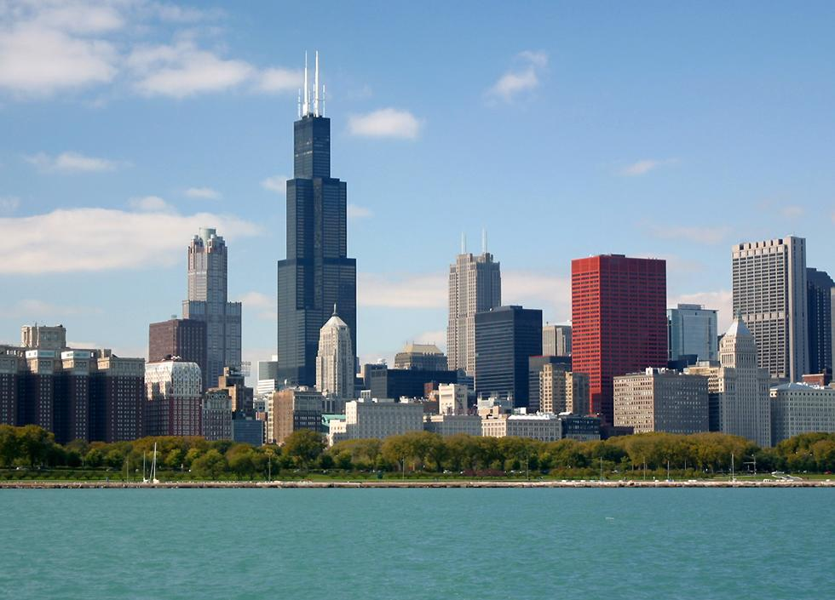
“[I]n the classical sense, civility and politeness are … indications of how life is to be best lived in cities in which citizens are dependent on one another and the state for functional relations within complex social networks.”
-- Civility: A Cultural History, Benet Davetian
Notes:
:18
Sample Dialogue
States and jurisdictions recognize the importance of civility in the legal life. Many states have enacted civility principles that remind lawyers at some point in their careers that they should be mindful of a code of civility, or principle of professionalism, in their every day practice.
Some of the concepts are basic: “I will be punctual” and “Shake hands” while others are more aspirational: “Improve the administration of justice” for example. But whether simple or complex, the goal is the same as Erasmus’s five hundred years ago – to promote an atmosphere of civil behavior to create a functional society.

Slide 18
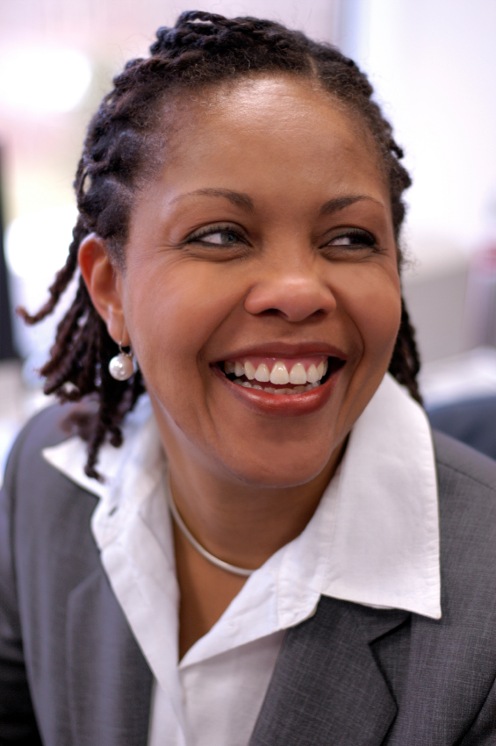
Ethical Tools to Defuse Incivility
Notes:
:19
This is the last slide prior to the hypothetical scenarios. This slide’s focus is on how we can get results using ethical and civil behavior.
Sample Dialogue
Unfortunately our profession has drifted away from these notions of civility. We face constant pressures from clients and coworkers. When we are faced with external pressures, we may choose a quick reaction: the angry email to opposing counsel; the harsh critique of a colleague. So uncivil behavior often is our innate reaction to an irritation.
We also may choose it because we think it gets results – insulting opposing counsel will make her think twice about opposing that discovery request; yelling at a junior associate will ensure he doesn’t screw up the motion next time. But, in fact, incivility often has the opposite effect. It doesn’t make the process quicker or more efficient, and it leads to resentment, anger, and bitterness in the relationship.
However if you’re faced with a situation where you are dealing with counsel who uses incivility as the major weapon in their arsenal, what do you do? Most civility professionalism issues do not present a black and white/right and wrong answer. We’ll now engage in some interactive discussion to determine how many of you would approach certain incivility scenarios.
For the next forty minutes or so, we’re going to use a hypothetical law firm to help us along. Instruct participants to reference the Scenarios handout which mirrors content on the slides. Let’s meet the law firm of Chapman & Becker.

Slide 19
Setting A : Chapman & Becker
Chapman & Becker is a general practice law firm that’s been around for about 25 years. Unfortunately, they haven’t fully recovered from the Recession. Rumors are flying that if they don’t get new clients soon, lay-offs will occur. We’re going to meet three Chapman & Becker attorneys with some thorny ethical and professionalism issues.
Notes:
:22
Summarize the content of the slide.

Slide 20
Divya Singh
Divya Singh is a litigation associate at Chapman & Becker. She’s been at Chapman & Becker for six years, ever since she graduated law school. She has a good relationship with all the partners there and they trust her independence and judgment. She’s also hoping to make partner soon.
Notes:
:23
Summarize the content of the slide.

Slide 21
Scenario #1
Divya has been assigned to an employment discrimination case. Her client, Karen, is a pregnant woman recently dismissed from her job. She strongly suspects that she was fired due to her pregnancy. Karen’s former boss, Deep Singh, says the reason was performance-based. The company does not have a formal review process and so it is essentially your client’s word against Deep’s.
Divya shares the same last name as Deep. Opposing counsel once mistakenly sent Divya an innocuous email intending to send it to Deep. Because she wanted to keep a civil relationship with opposing counsel, Divya sent back the email. Opposing counsel apologized and offered to reschedule a deposition to make Divya’s life easier. Divya appreciated the effort and thinks opposing counsel is a good, trustworthy attorney.
Notes:
:24
Summarize the content of the slide.

Slide 22
Scenario #1 (con’t)
Late one night, Divya receives an email from opposing counsel. Upon opening the email, she realizes that it’s again meant for Deep. The email states: “Deep, please review ASAP the attached document. It outlines the reasons we could very well lose this case to Karen, as well as our previously-discussed settlement strategy.”
What should Divya do?
Delete the email immediately.
Forward back the email without opening the attachment.
Read the attachment and delete the email.
Read the attachment and notify opposing counsel of the misdirected email.
Call opposing counsel and ask him what to do.
Notes:
:25
Allow approximately 5 minutes for discussion and reporting out. Ask participants to discuss with a partner and then ask for a few people from around the room to report the essence of the discussion. Alternatively, if the room is divided into round tables, ask one person from each table to report out. If the room is spread out with audience in chairs, take a poll of the room to see who chose what answers, then ask for volunteers to share their answers.
Sample Dialogue
The only action required to be taken under the Rules is to notify opposing counsel. RPC 4.4(b) states: “A lawyer who receives a document or electronically stored information relating to the representation of the lawyer’s client and knows that the document or electronically stored information was inadvertently sent shall promptly notify the sender.” The Comment to the Rule explains that “document” includes e-mail or other electronic modes of transmission subject to being read or put into readable form. The Comment to Rule 4.4 goes on to state: “Whether the lawyer is required to take additional steps, such as returning the original document, is a matter of law beyond the scope of these Rules, as is the question of whether the privileged status of a document has been waived.” Questions to ask – what is your prior relationship with counsel? What’s your future relationship with counsel? How will this impact the litigation? What would your client expect? Are these relevant considerations?

Slide 23
Scenario #2
Divya arrives in court for a routine motion. Opposing counsel has sent his partner to cover the hearing. During Divya’s argument, he mutters a condescending remark about Divya that she can hear clearly but the judge cannot. Divya continues but opposing counsel does it a second time.
What should Divya do?
Ask the judge to have counsel repeat his remarks.
Ask counsel to repeat the remarks and ask the judge to rule on the propriety of the remarks.
Say nothing and continue with her rebuttal.
Tell counsel directly to stop interrupting her.
Ask the judge to instruct counsel to stop talking during her rebuttal.
Notes:
:30
Allow approximately 5 minutes for discussion and reporting out. Ask participants to discuss with a partner and then ask for a few people from around the room to report the essence of the discussion. Alternatively, if the room is divided into round tables, ask one person from each table to report out. If the room is spread out with audience in chairs, take a poll of the room to see who chose what answers, then ask for volunteers to share their answers.
This question does not have a Sample Answer and fully depends on the facilitator’s perspective and experience. Please incorporate other comments in the room into your remarks.

Slide 24
Jimmy O’Rourke
Jimmy O’Rourke is a family law partner at Chapman & Becker. He’s known for being particularly aggressive when it comes to divorce cases. Clients seek him for that aggression and combativeness.
A new client shows up one day, Susan Lewis. Susan is the CEO of a Fortune 50 company and wants Jimmy to represent her in a potentially high-profile divorce. She’s never used Chapman & Becker and Jimmy knows that getting her as a client could lead to getting her company as a client as well.
Notes:
:37
Summarize the content of the slide.

Slide 25
Scenario #3
Susan wants to file for divorce on the basis of adultery. She shows Jimmy an anonymous letter she received with a picture of her husband and their Nanny in a compromising position. The person wrote: “This has been going on for months! Pics are ALL OVER her Facebook!!” Susan wants Jimmy to “friend” the Nanny and download all those pictures.
Jimmy wants to know what he can ethically do.
Friend the Nanny on Facebook.
Get his secretary to Friend the Nanny on Facebook.
Have Susan use her husband’s account to access the Nanny’s Facebook page.
None of the above.
Notes:
:38
Allow approximately 5 minutes for discussion and reporting out. Ask participants to discuss with a partner and then ask for a few people from around the room to report the essence of the discussion. Alternatively, if the room is divided into round tables, ask one person from each table to report out. If the room is spread out with audience in chairs, take a poll of the room to see who chose what answers, then ask for volunteers to share their answers.
Sample Dialogue
First of all, remember Rule 8.4: “It is professional misconduct for a lawyer to: (a) violate or attempt to violate the Rules of Professional Conduct, knowingly assist or induce another to do so, or do so through the acts of another.”
For A., the Nanny does not appear to be represented by counsel therefore Rule 4.2 would not apply (“In representing a client, a lawyer shall not communicate about the subject of the representation with a person the lawyer knows to be represented by another lawyer in the matter, unless the lawyer has the consent of the other lawyer or is authorized to do so by law or a court order.”) Jimmy could contact the Nanny via Facebook. However, if he does, he can’t misrepresent and mislead pursuant to Rule 4.1 (“In the course of representing a client a lawyer shall not knowingly: (a) make a false statement of material fact or law to a third person; or (b) fail to disclose a material fact when disclosure is necessary to avoid assisting a criminal or fraudulent act by a client, unless disclosure is prohibited by Rule 1.6.”)
For B. and C., again under Rule 8.4, “It is professional misconduct for a lawyer to: (a) violate or attempt to violate the Rules of Professional Conduct, knowingly assist or induce another to do so, or do so through the acts of another.” Jimmy’s secretary could contact the Nanny through Facebook but she cannot misrepresent who she is. Similarly, if Jimmy can’t access the Nanny’s Facebook using the husband’s account, he can’t ask his client to do the same think either.
The closest correct answer therefore may be D., none of the above.

Slide 26
Scenario #4
Susan comes back a month later. She and her husband have officially separated, the Nanny’s quit her job, and the Nanny and the husband are now living together. Susan’s livid. She demands Jimmy sue the Nanny for breach of contract, tortious interference, defamation and any other cause of action he can think of. She wants him to list every scandalous fact about her husband in the complaint. She also wants him to get the Nanny deported. She doesn’t care if it’s dismissed and she reminds Jimmy that she hired him based on his aggressive reputation.
What should Jimmy do?
File a complaint against the Nanny and include every conceivable legal theory and salacious fact.
Tell Susan that he can no longer represent her.
Remind Susan about his professional responsibility obligations.
Send the Nanny a letter threatening to report her to Homeland Security.
Notes:
:45
Allow approximately 5 minutes for discussion and reporting out. Ask participants to discuss with a partner and then ask for a few people from around the room to report the essence of the discussion. Alternatively, if the room is divided into round tables, ask one person from each table to report out. If the room is spread out with audience in chairs, take a poll of the room to see who chose what answers, then ask for volunteers to share their answers.
Sample Dialogue
The Rules of Professional Conduct expressly forbid A. (Rule 3.1: “A lawyer shall not bring or defend a proceeding, or assert or controvert an issue therein, unless there is a basis in law and fact for doing so that is not frivolous, which includes a good-faith argument for an extension, modification or reversal of existing law.” The Rules of Professional Conduct also expressly forbid D. (Rule 8.4(g): “It is professional misconduct for a lawyer to … (g) present, participate in presenting, or threaten to present criminal or professional disciplinary charges to obtain an advantage in a civil matter.”
B or C are both discussion questions. How valuable is Susan as a client? How can you make Susan understand the obligations you are under as an attorney? If Susan sought you for your aggressive behavior, how do you explain to her where you cross the line? How will you justify losing this client to your law firm?
Ask the group what they would do and why. Remind them of the RPC reasons they can’t do A and D, but note that B and C are also difficult to do.

Slide 27
Candace Jackson
Candace is a partner at Chapman & Becker. Rumors abound that Candace often comes very close to the ethical line in her litigation practice. Rumors also abound that Candace, who customarily has a large book of business, has struggled to bring in business this year. Candace appears to be becoming increasingly nervous about her book given the general state of Chapman & Becker. However, she does have one large matter that may go to trial in about seven months.
Notes:
:52
Summarize the content of the slide.

Slide 28
Scenario #5
Divya gets assigned to Candace’s case. Candace instructs Divya to work overtime on trial prep. Divya thinks that Candace is churning the bill, but she’s not in contact with the client and doesn’t know what the client thinks.
What should Divya do?
Tell Candace that trial prep is premature and ask that she rethink her plan of action.
Find out from the client if they know about and approve the trial prep activities.
Ask a partner for guidance.
Ask an associate for advice.
Notes:
:53
Allow approximately 5 minutes for discussion and reporting out. Ask participants to discuss with a partner and then ask for a few people from around the room to report the essence of the discussion. Alternatively, if the room is divided into round tables, ask one person from each table to report out. If the room is spread out with audience in chairs, take a poll of the room to see who chose what answers, then ask for volunteers to share their answers.
Sample Dialogue
This hypothetical gives rise to a number of practical professionalism questions for a young junior attorney. A. implicates how to survive as a savvy associate in a firm where you disagree with the partner and want to keep your license. We all are responsible for ethical rules regardless of whether a superior has directed us to do something (see Rule 5.2). Is Rule 1.1 involved? “A lawyer shall provide competent representation to a client. Competent representation requires the legal knowledge, skill, thoroughness and preparation reasonably necessary for the representation.” Are these trial prep actions necessary for the litigation?
Among other rules, B. implicates Rule 1.3: “A lawyer shall act with reasonable diligence and promptness in representing a client.” Again, where is the line between zealous advocate and churning the bill? Has Candace crossed the line here? Similarly, Rule 1.5: “A lawyer shall not make an agreement for, charge, or collect an unreasonable fee or an unreasonable amount for expenses.” The rule also requires that the basis of the fee be communicated to the client either before or within a reasonable time after commencing the representation. The facts do not state that Candace communicated that information….is this Divya’s concern? Finally, Rule 1.4: “A lawyer shall: (1) promptly inform the client of any decision or circumstance with respect to which the client’s informed consent, as defined in Rule 1.0(e), is required by these Rules; (2) reasonably consult with the client about the means by which the client’s objectives are to be accomplished; (3) keep the client reasonably informed about the status of the matter; (4) promptly comply with reasonable requests for information; and (5) consult with the client about any relevant limitation on the lawyer’s conduct when the lawyer knows that the client expects assistance not permitted by the Rules of Professional Conduct or other law. (b) A lawyer shall explain a matter to the extent reasonably necessary to permit the client to make informed decisions regarding the representation.” Should the client know about these trial prep activities? Would Divya informing the client constitute reasonable action?
C. and D. are both professionalism questions rather than ethics questions. Who should Divya seek advice from – a partner who may not be sympathetic to her plight or the associates in her firm who may be more sympathetic but would have less ability to obtain a solution? When we tell our younger attorneys where to turn in an ethical or professional dilemma, who should we tell them to turn to?

Slide 29
Illinois Supreme Court Commission on Professionalism
Two Prudential Plaza Suite 1950
180 N. Stetson Avenue
Chicago, IL 60601
312-363-6210
mail@2civility.org
www.2civility.org
Notes:
:58
This is the wrap-up and conclusion. You should take any audience questions and offer your email address or phone number for further conversation and follow-up. We have included our contact information here. You are welcome to replace our information with your own.
Thank you for using this PowerPoint. The Commission on Professionalism is pleased to share this presentation as a resource to enhance the civility of the bar. If using the presentation in part or in its entirely, please keep the first and last slides to provide proper attribution. Please contact the Commission should you have any questions.

