Slide 1
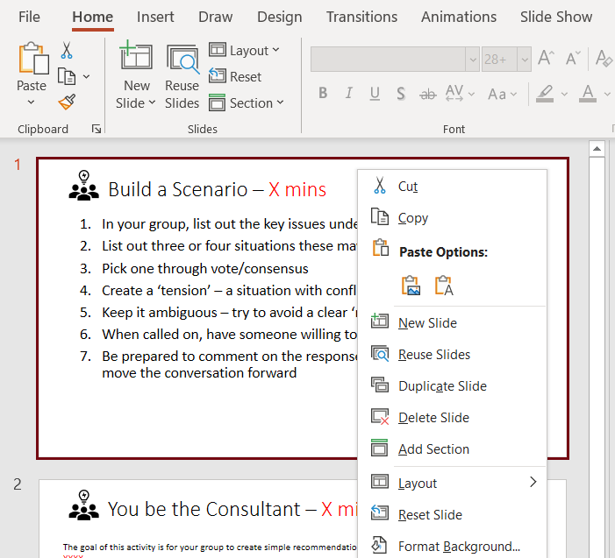
Make your presentations more engaging with these activity slide templates.
TO USE THESE TEMPLATE SLIDES:
Right-click on your desired slide’s thumbnail on the left. Select “Copy.”
Right-click and select “Paste” to add the template slide to your presentation.
Customize the template slide as you wish.

Slide 2
TEMPLATE 1: Build a Scenario – X mins
In your group, list the key issues under discussion
List three or four situations where these may occur
Pick one through vote/consensus
Create a "tension" – a situation where conflicting choices are present
Keep it ambiguous – try to avoid a clear right answer
Designate a member of your group to present your scenario to the larger group
Be prepared to comment on the responses; keep it positive and move the conversation forward

Slide 3
TEMPLATE 2: You be the Consultant – X mins
The goal of this activity is to create simple recommendations based on the information you have about XXXX.
Feel free to make reasonable assumptions, but make sure you communicate them when reporting your recommendations to the whole group.
Read through the scenario documents.
Consider obvious barriers (no unlimited budgets, etc.).
Identify any assumptions you make.
Discuss possible solutions.
Formulate a cohesive plan.
Share your solutions with the larger group; be prepared for challenges and questions.

Slide 4
TEMPLATE 3: Group Discussion – X mins
In your groups, discuss the following question:
How will XXX impact your interactions with clients and what steps can you take to mitigate negative outcomes?
Before you start, make sure your group:
Appoints a Chairperson – this individual will ensure each member's contributions are heard and summarize key points to move the conversation forward.
Allow time for people to think through and record their responses.
Explore counter positions as a way of testing any agreed-upon conclusions.

